Slide 1
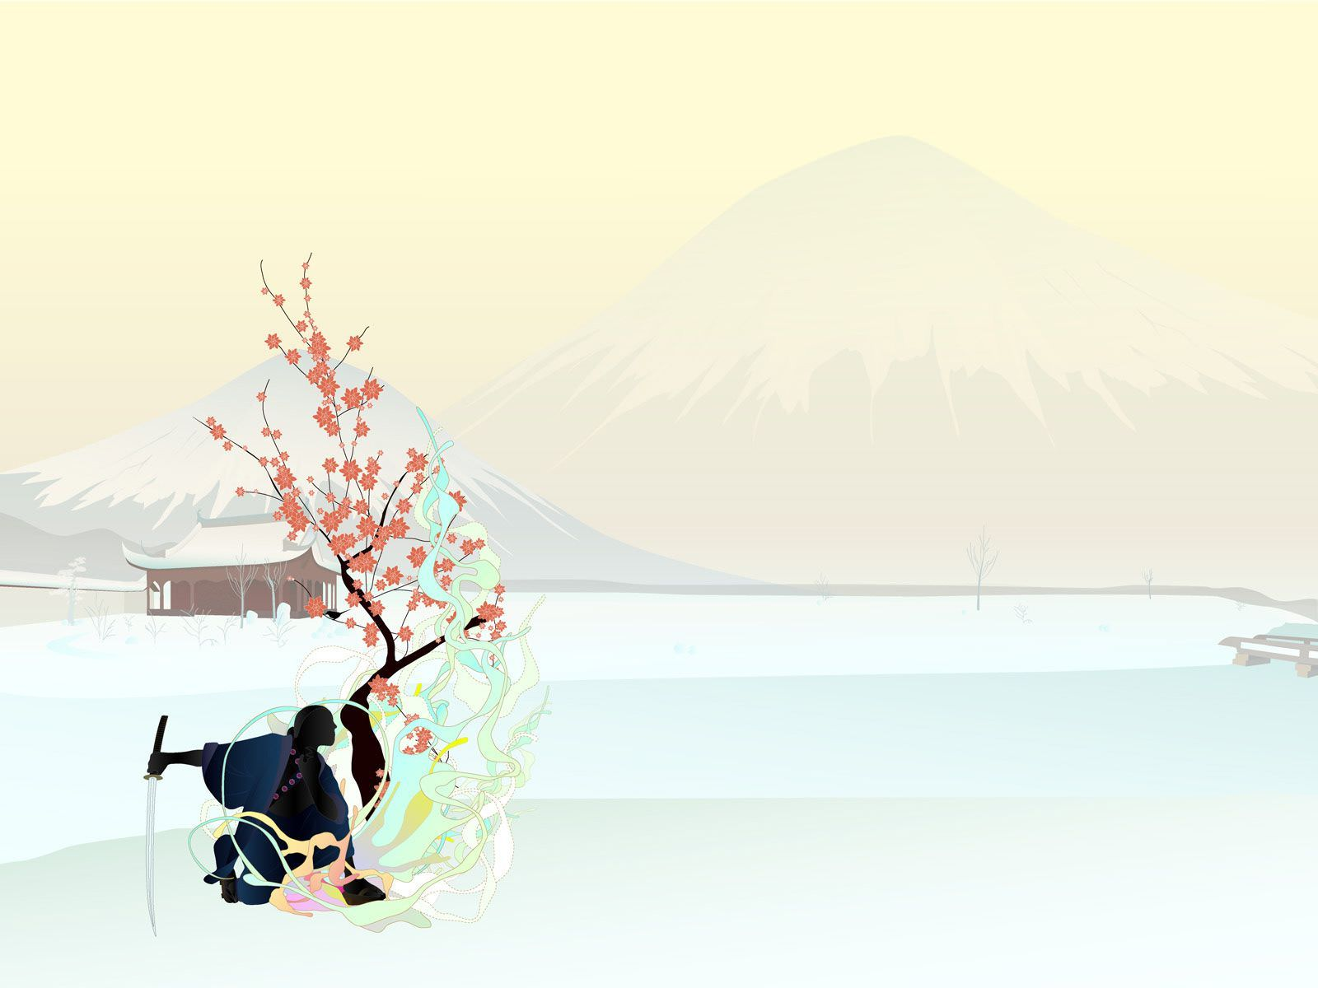

ENGLISH ASSIGNMENT 1.1
TOPIC: A Cultural Event
HANAMI FESTIVAL
Teacher : | NguyenNH
Student : | Nguyen Quoc Tuan
SID : | PH08378
Class : | ENT1123.1

Slide 2
OUTLINE
I. INTRODUCTION
Overviews of Japan
II. BODY
1. All of Hanami Festival
2. Traditional Food - Cultural Activities during Hanami Festival
3. My Experience and Feelings of Hanami
III. CONCLUSION
Hanami and The Last words

Slide 3
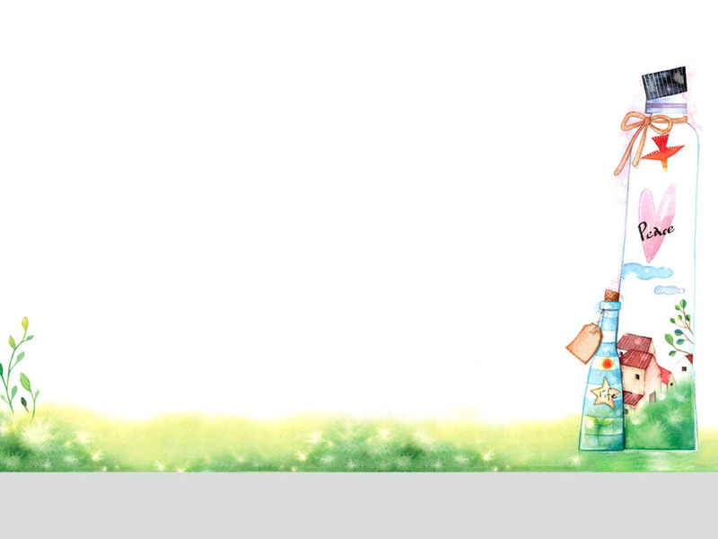
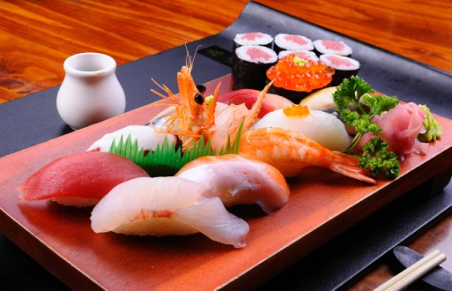
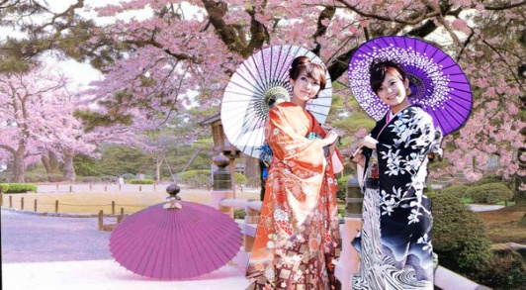
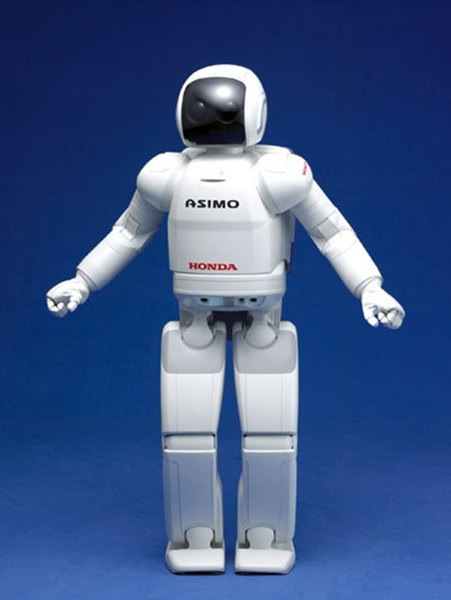
I.INTRODUCTION
Traditional Food
JAPAN
Traditional Clothes
Technology

Slide 4

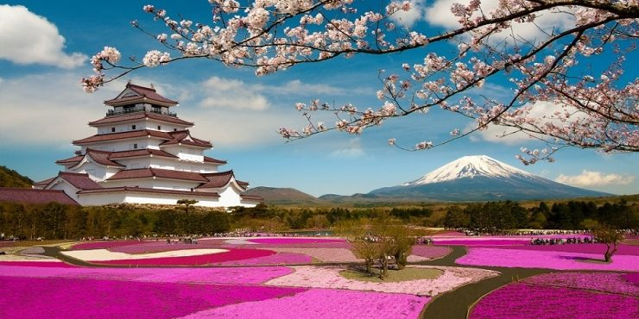
Cultaral event
Hanami Festival

Slide 5

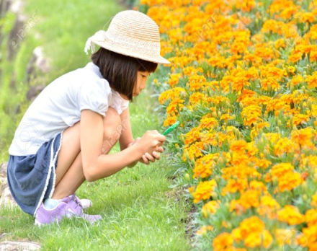
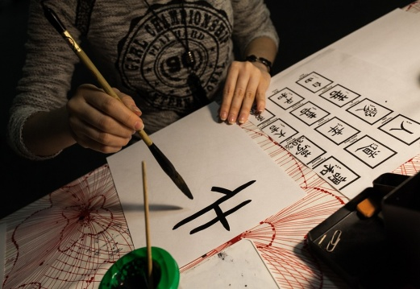
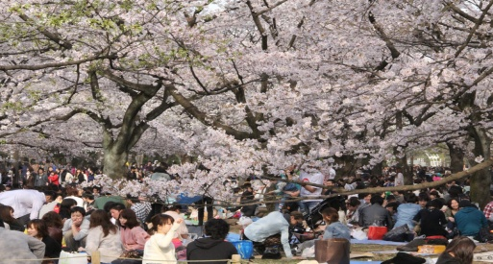
II. Body
1.All of Hanami Festival
The Meaning
Hanami
Concept
Origin
Today

Slide 6

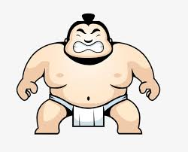
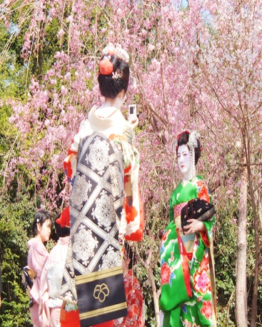
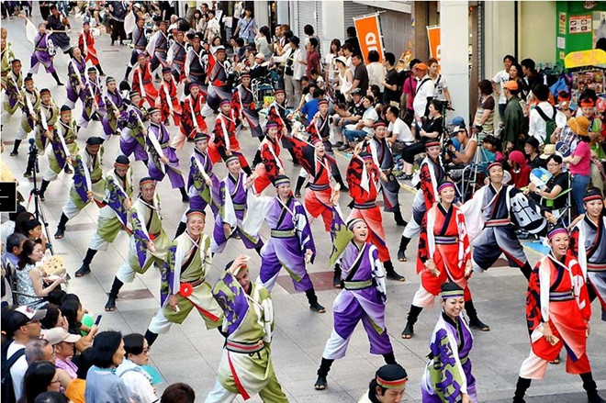
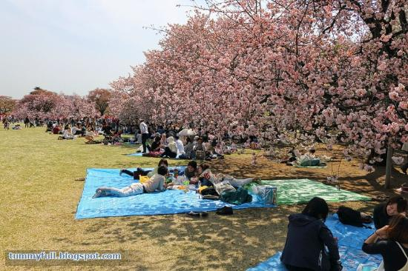
What will People do in The Hanami Festival?
Sumo Boxers
Street Performers
Kimono
Picnic

Slide 7

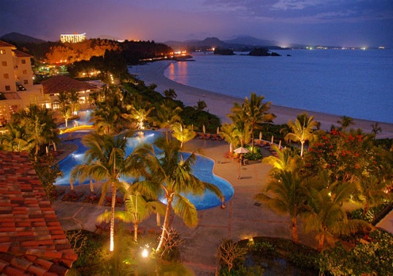
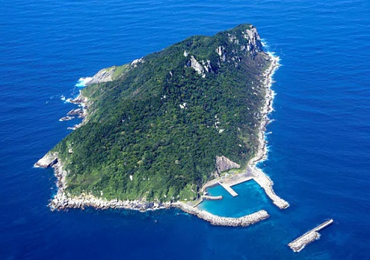
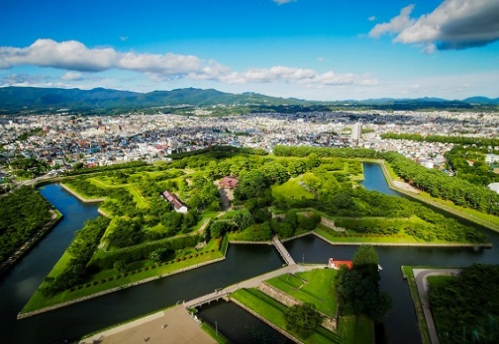
TIME
HANAMI
FESTIVAL
January
OKINAWA
March
HONSHU
April
May
HOKKAIDO

Slide 8

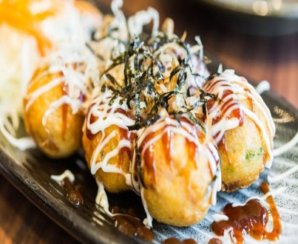
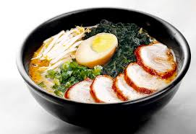
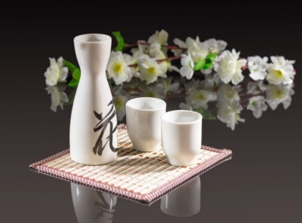
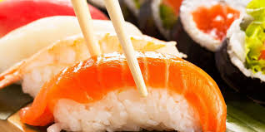
2. TRADITIONAL FOOD-CULTURAL ACTIVITIES
TRADITIONAL
FOODS-DRINKS

